Slide 1
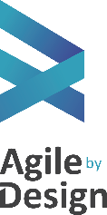
Agile Internal Training Day 2

Slide 2
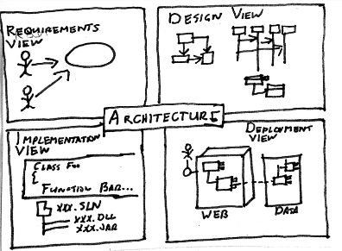
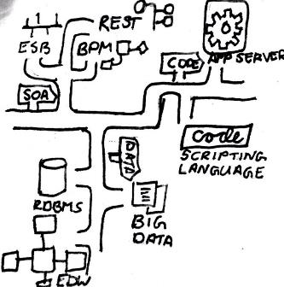
Domain Modeling With Class Responsibility Cards and Domain Driven Design

Slide 3
The number one reason for failure of software projects is a failure of people to communicate
Language wall between clients and developers)
Domain Models are a Ubiquitous Language,
tight collaboration from both business and delivery teams
drawn in the language of the business
constrained by technology, using technical structure
One model for the code, the diagrams, and the language people use!
Business terms, concepts, etc, used by solution
Business terms not part of the scope of the solution
Business Logic layer of solution
Business logic layer of solution
Business terms part of the of the solution, that are not explicit in the solution
Business aspects of all layers of the solution (UI, DB, etc)

Slide 4
The number one reason for failure of software projects is a failure of peopleto communicate
One layer of the solution is built using the language of the model
For cut dev this is the business logic layer
For package, the interfaces and testing layer are good candidates
Use one set of terms across the solution and problem space
Language permeates stories, test cases, database, service methods, etc
One model for the code, the diagrams, and the language people use!

Slide 5
Two Agile Methods Key to Building A Domain Model
Class responsibility Card Modelling
An Agile Modelling technique to visually represent whole or part of an application or problem domain
Quickly explore, shape, and discard domain concepts
We will be using CRC to practice Domain Driven Design
Domain Driven Design
An agile methodology for evolving a software system that closely aligns to business requirements
A Practice to Maintain a Domain Model
A selective abstraction of knowledge from business domain experts
Responsible for representing business concepts, information about business situations, business state, and business rules
Evolves to represent the constraints of the technical solution as it becomes more well understood
A common, ubiquitous language to express business terms using a vocabulary that both technical and business can use

Slide 6
Domain Modelling with CRC

Slide 7
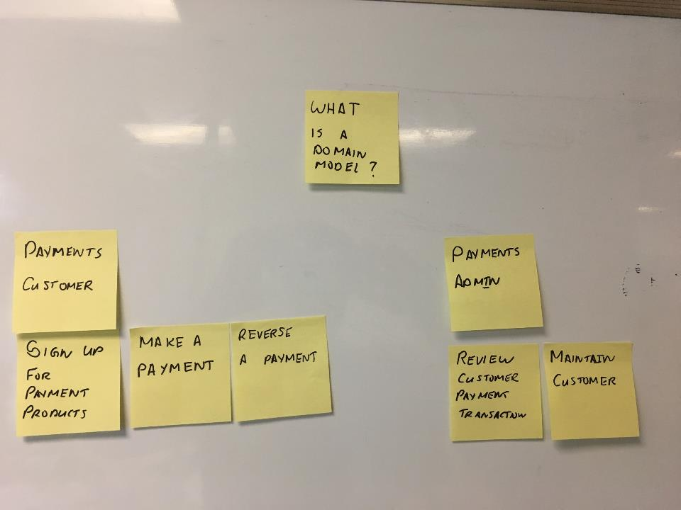
Starting Simple: Using A Domain model to elaborate on our story map

Slide 8
Starting Simple: Using A Domain model to elaborate on our story map
Payments Customer
Payments Admin
Sign Up For Payments Products
Make A Payment
Reverse A Payment
Review Customer Payment
Maintain Customer

Slide 9
Starting Simple: Using A Domain model to elaborate on our story map
What do we mean by a payments customer?
User? Company? Department? Representative?
How Do we ID one?
Payments Customer
Payments Admin
Sign Up For Payments Products
Make A Payment
Reverse A Payment
Review Customer Payment
Maintain Customer
What Information is required to make a payment?
What needs to be tracked
What States can a Payment have?

Slide 10
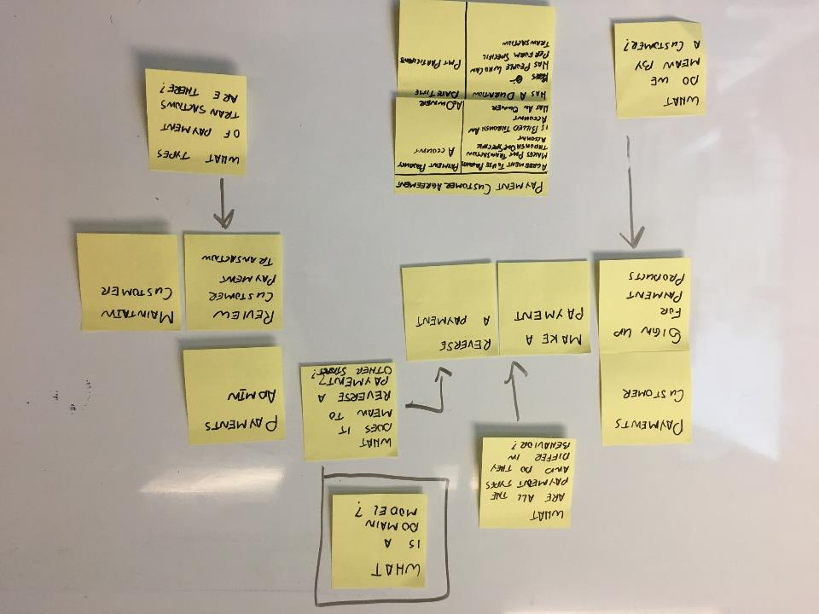
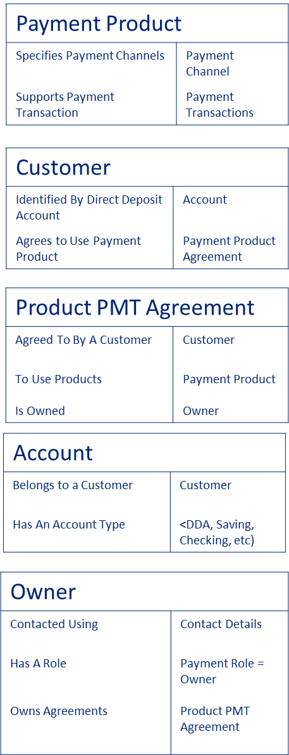
Answers to these questions can be captured in a Domain Model, using CRC notation
Account
Belongs to a Customer | Customer
Has An Account Type | <DDA, Saving, Checking, etc)
Customer
Identified By Direct Deposit Account | Account
Agrees to Use Payment Product | Payment Product Agreement
Payments Customer
Payments Admin
Sign Up For Payments Products
Make A Payment
Reverse A Payment
Review Customer Payment
Maintain Customer
Product PMT Agreement
Agreed To By A Customer | Customer
To Use Products Is Owned | Payment Product Owner

Slide 11
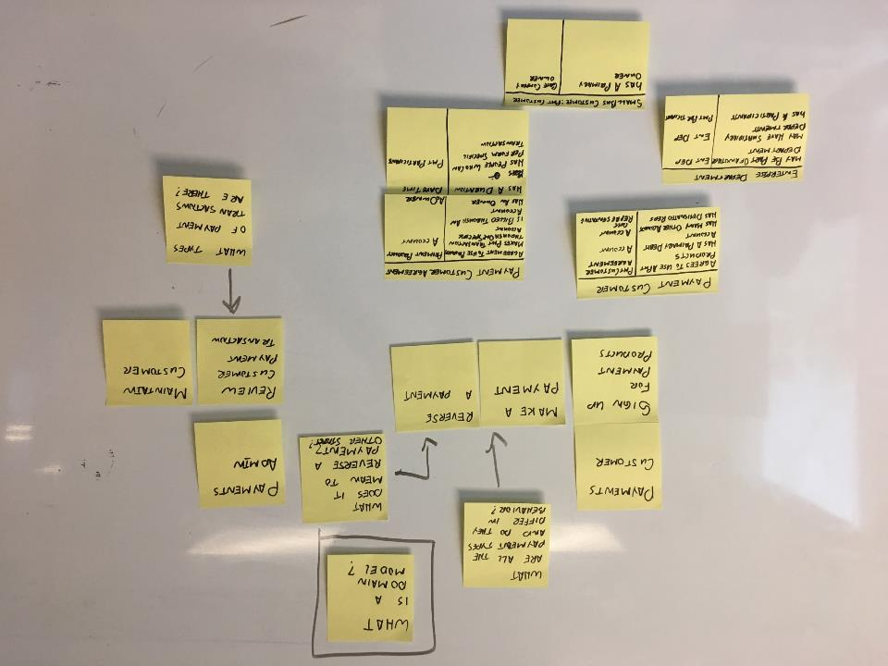
Answers to these questions can be captured in a Domain Model, using CRC notation

Slide 12
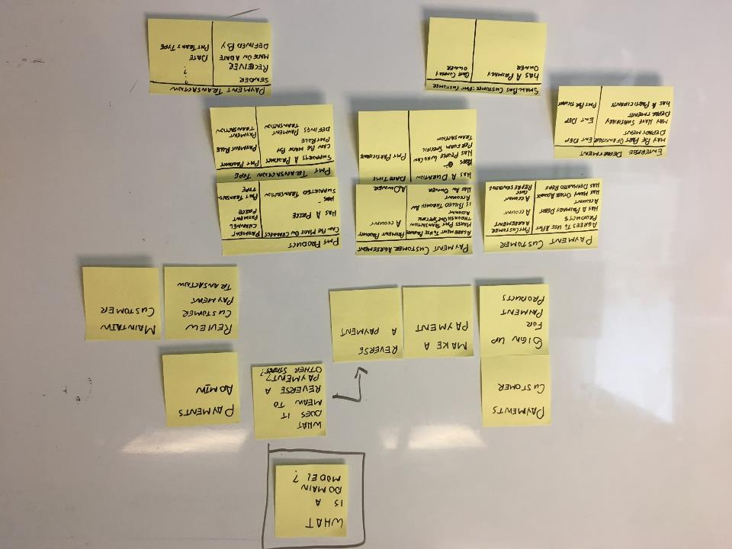
Answers to these questions can be captured in a Domain Model, using CRC notation

Slide 13
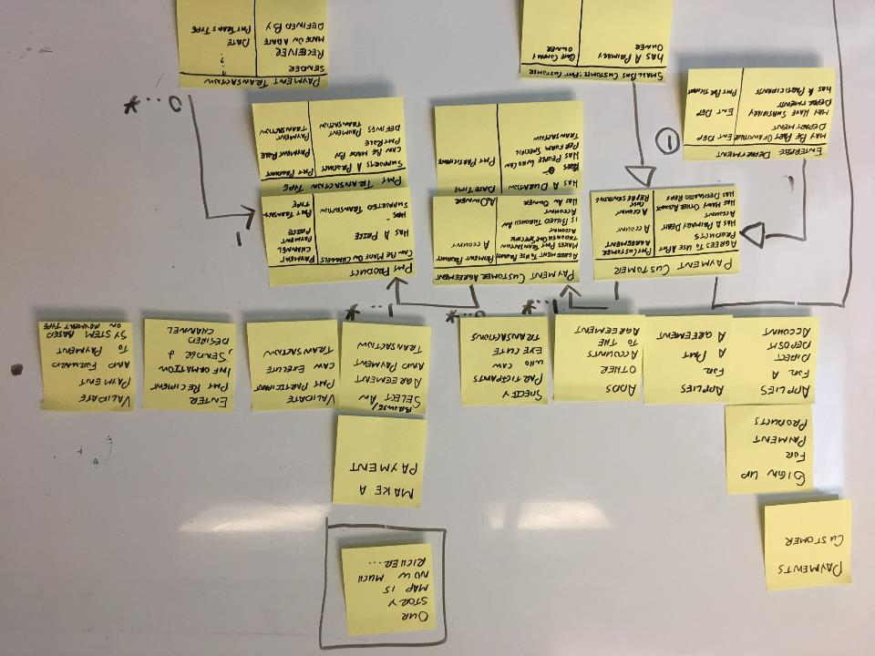
A good Domain Model dramatically increases the pace of story discovery and exploration, domain concepts are captured in one place as understanding increases

Slide 14
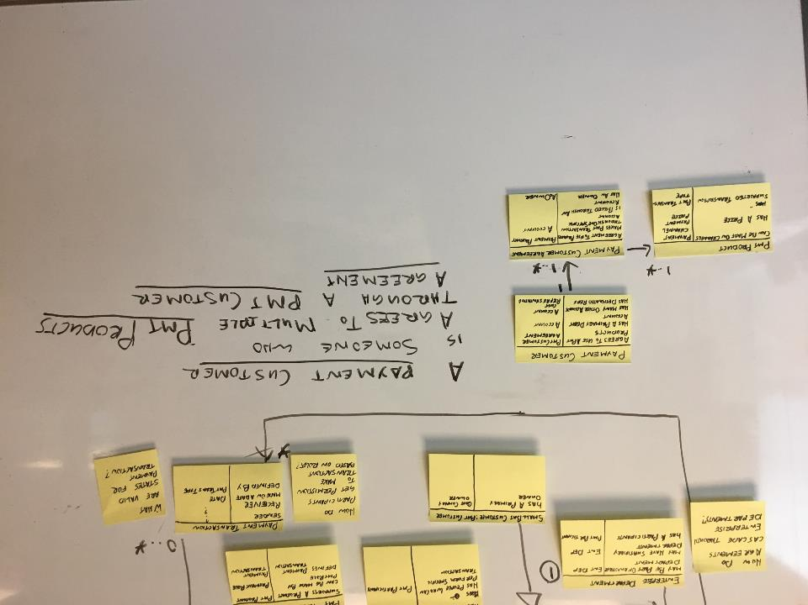
Language is as (or more) important the diagram. Practice walking the model, describing each piece, this builds the common vocabulary being used by the team

Slide 15
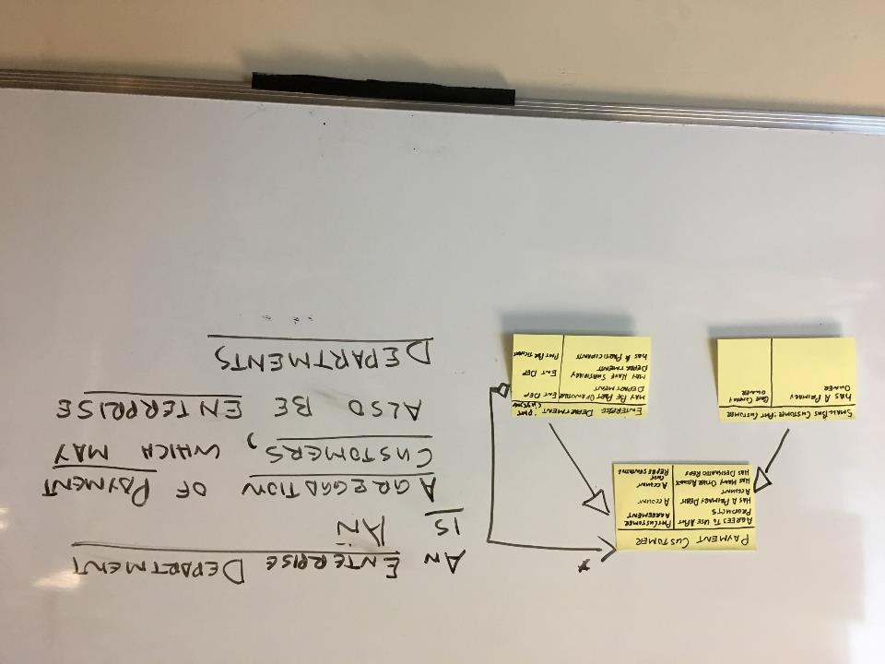
Language is as (or more) important the diagram. Practice walking the model, describing each piece, this builds the common vocabulary being used by the team

Slide 16
Coaching Thoughts
Building a domain accelerates story mapping, acceptance criteria, and Spec by example
There is a steep learning curve, and the initial complexity can / will put people off
It scales! Most of the work happens during the first few stories in an epic, covering additional stories become progressively easier and easier
For developers, it can feel like coding with stickies

Slide 17
Exercise: Story Map and Domain Questions
Outline a Story Map that captures some aspect of a project you are part of,
Keep it brief focus on the major epics, listing perhaps a few stories
Capture any questions you have regarding the business domain, ie business concepts, state, rules, logic or data

Slide 18
CRC components 101

Slide 19
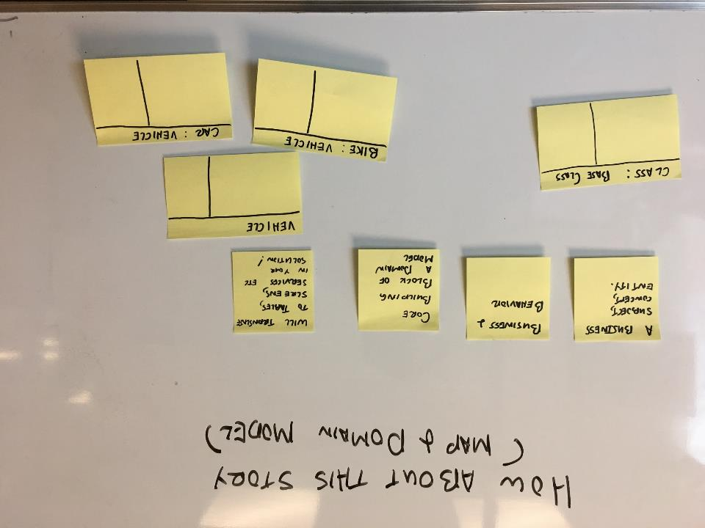
Each discrete part of the domain is captured as a Class

Slide 20
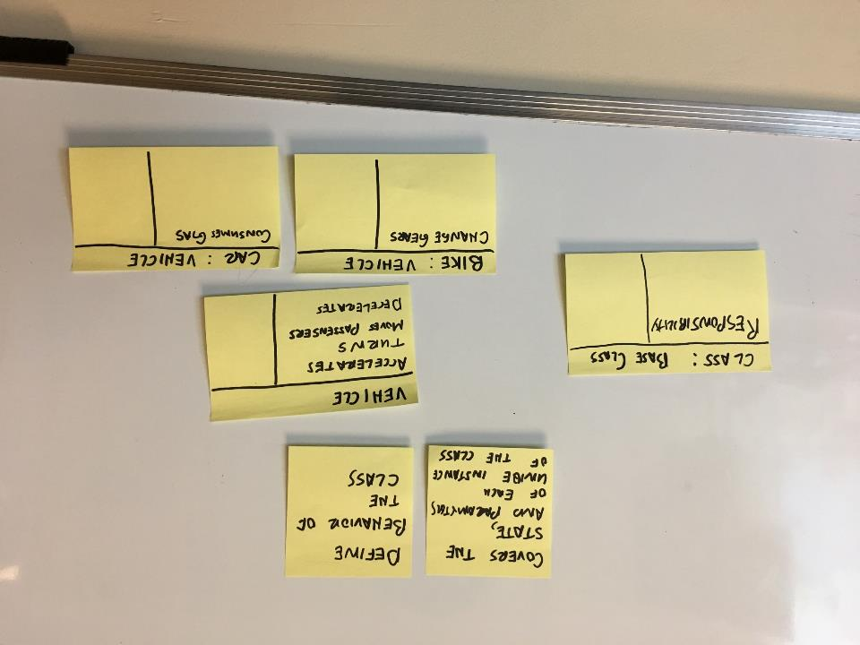
Responsibilities are added to classes, and define the behaviour and data of that class

Slide 21
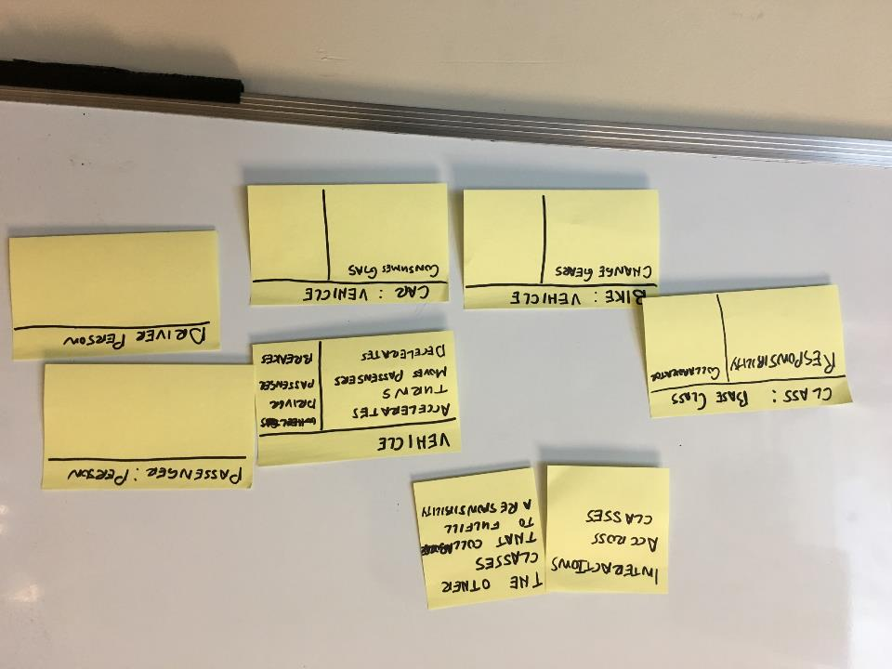
Collaborators define the other classed that participate to fulfill a specific responsibility

Slide 22
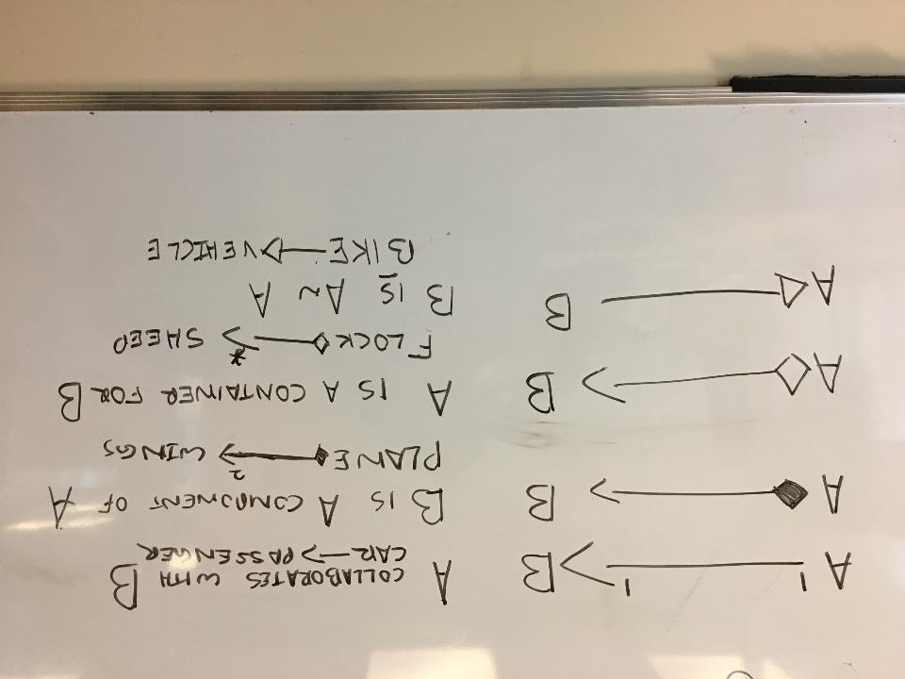
Object oriented notation can be used to further define the relationships between various classes

Slide 23
Putting it together, a precise and concise way to describe how business logic works, in a format that can be easily translated to the actual solution

Slide 24
Putting it together, a precise and concise way to describe how business logic works, in a format that can be easily translated to the actual solution

Slide 25
Domain Modelling throughout the agile lifecycle

Slide 26
Flesh out your domain model in parallel with story exploration
Start by modelling functional behaviour (story map, acceptance criteria, spec by example, etc)
Ask domain related questions
What do you mean by X?
Explain the difference between an X and a Y
Describe all the different types of XWhat happens When X does Y?
What the F&@@!& is an X again?
Rephrase the answer in the domain model format (ah ha! So an X is for/does/behaves like….)
Update your model to capture the insight
Update your stories as necessary
Pause every so often and walk the model

Slide 27
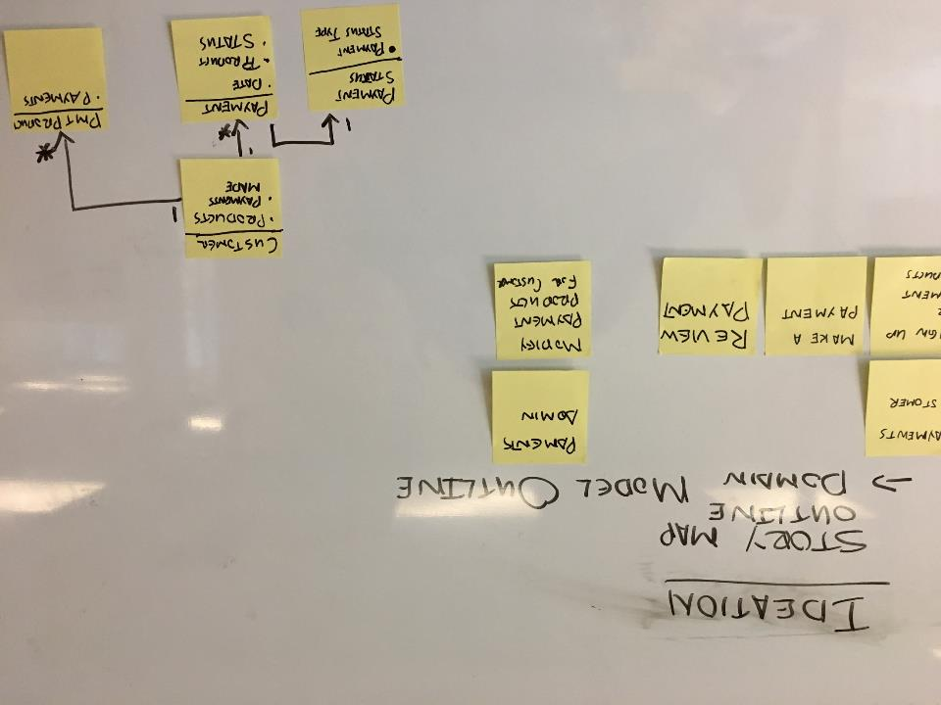

Slide 28
Exercise: Outline your Domain Model
Walk through your story map and build out an initial domain model
Don’t worry about being complete or precise, focus on major concepts and responsibilities

Slide 29
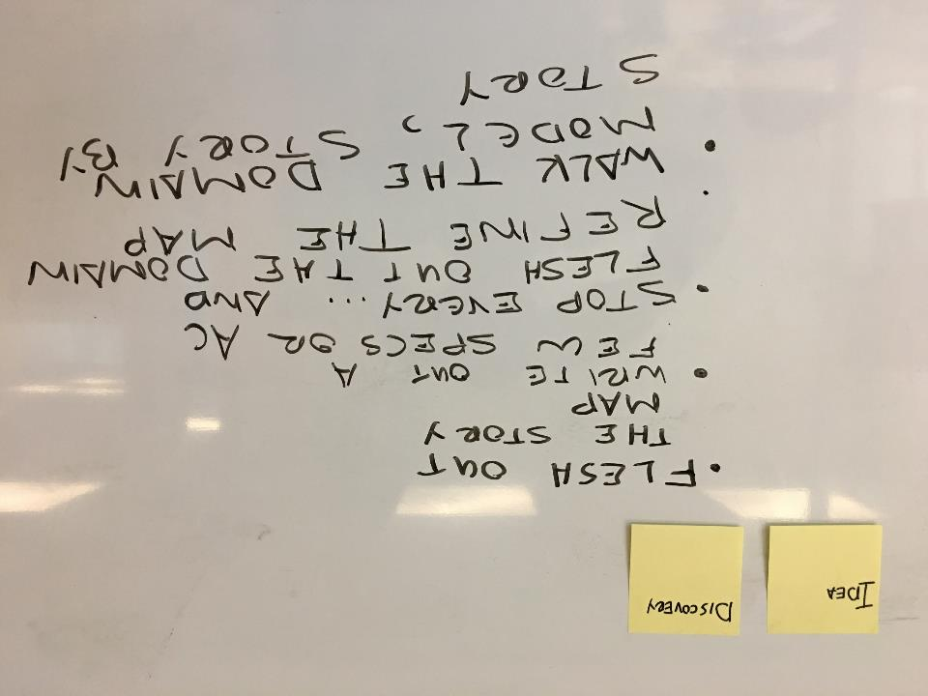

Slide 30
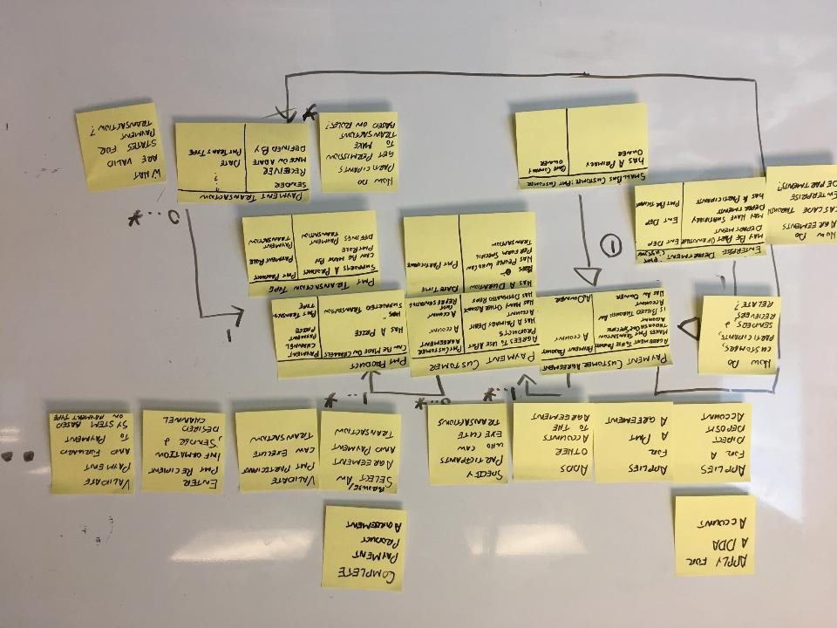

Slide 31
Exercise: Flesh out your Domain Model
Refine your story map to a greater level
Add details around some key functions and stories, try to tack each major domain area in part
Refine the domain model to answer domain questions across each story

Slide 32
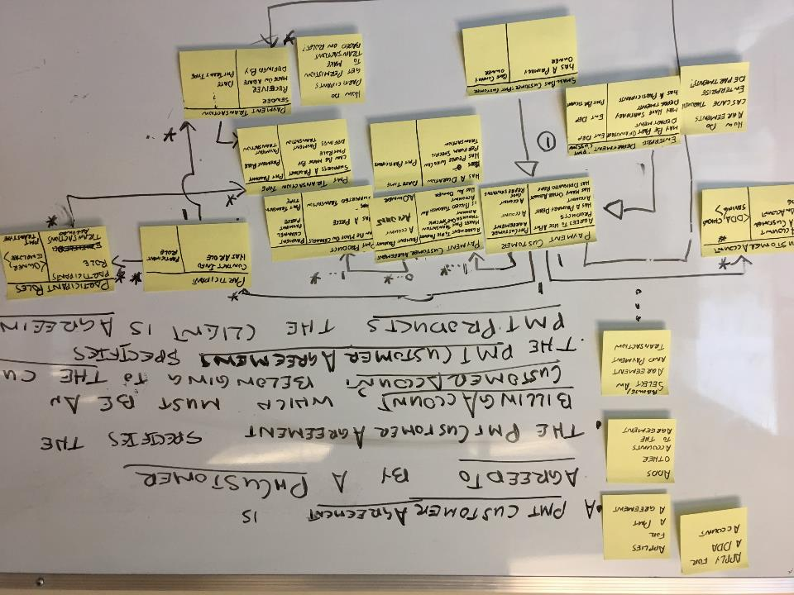
Validate the domain model by walking through individual stories, tracing the connections and collaborators in the map to see if there is a missing concept

Slide 33
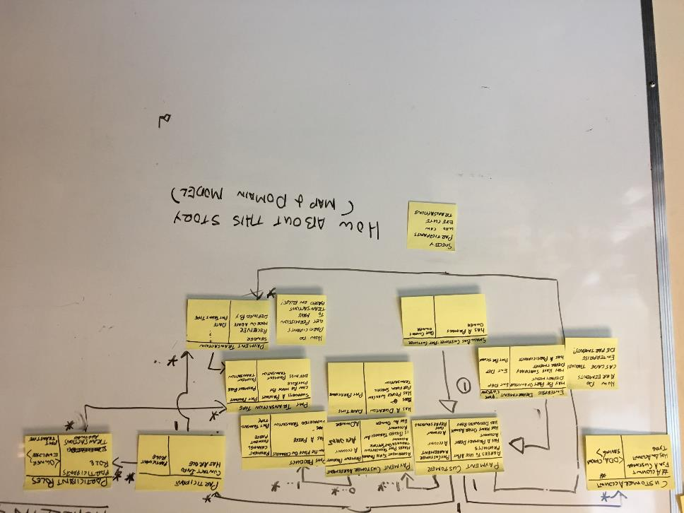
Can the class take a crack at walking the domain model using this story? Does it reveal any missing pieces in the model?

Slide 34
Exercise: Validate your domain model through walkthroughs
Take a set of stories and walk the model to validate the model is complete
Take note of missing sections and update your model as necessary
Refine the domain model to answer domain questions across each story
Present the model to the class

Slide 35
Acceptance criteria are easier to do with a domain model in place
Account
Belongs to a Customer | Customer
Has An Account Type | <DDA, Saving, Checking, etc)
Idea
Discovery
Delivery
Apply For a Payment Product Agreement
Story Acceptance Criteria
The Customer must provide a valid DDA Account that the Customer owns
The Customer may apply for one or more Payment Products, each application results in a separate Payment Product Agreement
Each Ap
The Customer must specify an Owner, providing the necessary Contact Details
Customer
Identified By Direct Deposit Account | Account
Agrees to Use Payment Product | Payment Product Agreement
Product PMT Agreement
Agreed To By A Customer | Customer
To Use Products Is Owned | Payment Product Owner
Owner
Contacted Using | Contact Details
Has A Role Owns Agreements | Payment Role = Owner Product PMT Agreement
Acceptance criteria also provide excellent input into your domain model!

Slide 36
Detailed Domain Modelling and Spec by Example can be done in parallel
Idea
Discovery
Delivery
Apply For a Payment Product Agreement
Story Scenario
Given the following Payments Products exist
And the following Customer exist
With a valid DDA Account
When the Customer applies for a Payment Product Agreement
using his DDA Account
with an Owner
that has the following Contact Details
Then the Payment Product Agreement will be submitted to…
Acceptance criteria are also an excellent time to build and refine your domain model!

Slide 37
Exercise: Detail the Domain Model
Take an individual story and define it in terms of Acceptance Criteria and / or Specification Scenarios
Write each AC / Scenario step in a way that explicitly calls out the concepts in your domain model
Elaborate / refine the domain model as you go
Validate the domain model by walking through the story

Slide 38
Refining your Modelling

Slide 39
There are a lot of traps to avoid when writing a domain models, follow these best practices:
Avoid many to many relationship create a card to represent the relationship
Avoid dependency magnets break up classes with to many responsibilities into discrete domain concepts
Evolve “generic” responsibilities into domain specific ones
Use Abstractions Push behavior found in multiple places into a common class; use inheritance to “inject” the common behavior into these subject areas
Meta Layer consider moving the configurable part into a separate set of classes, known as a “meta layer”
Walk the Model whenever getting “lost in the model ground the conversation by walking the model through a scenario
Connect to architecture “Annotate and inject” common functionality through inheritance, and collect common behavior into a set of requirements that influence the choice of technology, patterns and/or APIs
Establish boundaries Where multiple teams / systems connect and overlap, call out mapping and integration mechanism; try to express dependencies in terms of specific domain concepts
As a Class which of these do we want to explore?

Slide 40
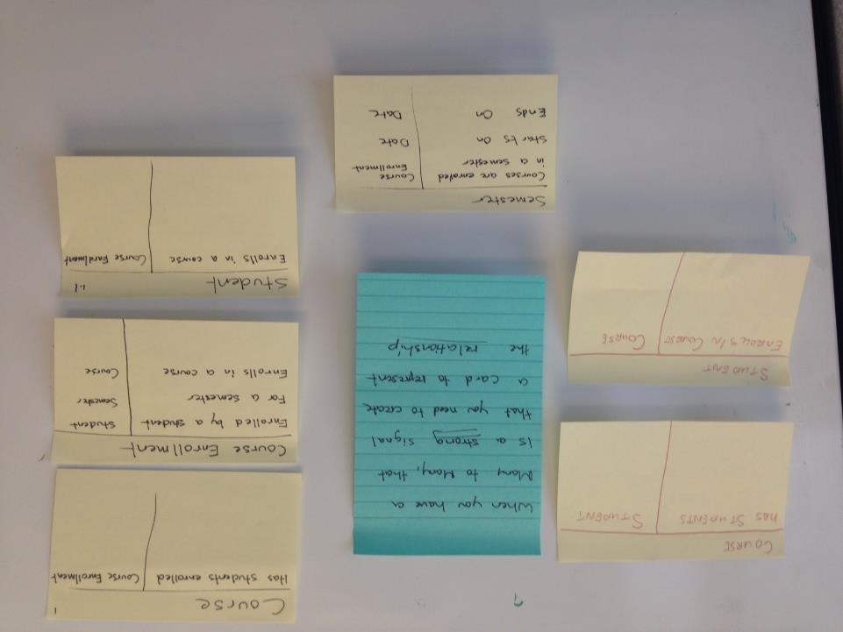
When you have a many to many relationship, that is a STRONG signal that you need to create a card to represent the relationship

Slide 41
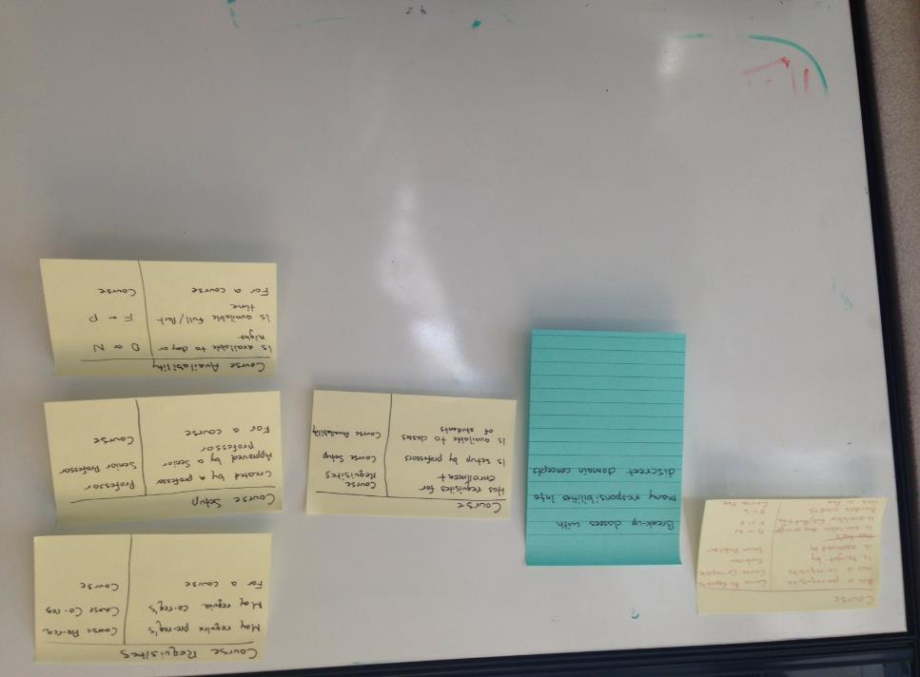
Avoid dependency magnets; break up classes that have too many responsibilities into discrete domain concepts that match the business language used to describe different concepts being represented by the class

Slide 42
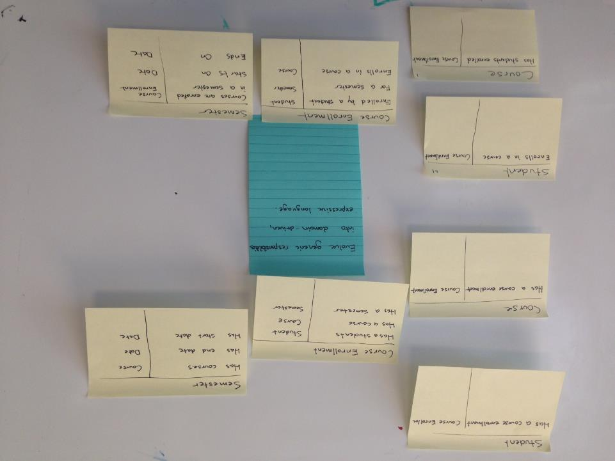
Evolve “generic” responsibilities and collaborations into responsibilities that are domain driven, and express the business language involved

Slide 43
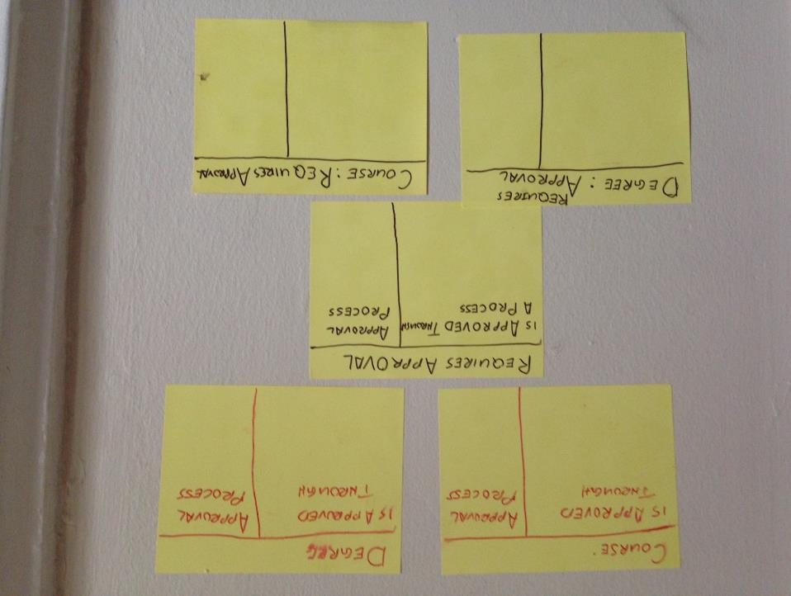
Consider pushing behavior found in multiple places into a common class that describes the key domain concept common across domain subject areas; use inheritance to “inject” the common behavior into these subject areas

Slide 44
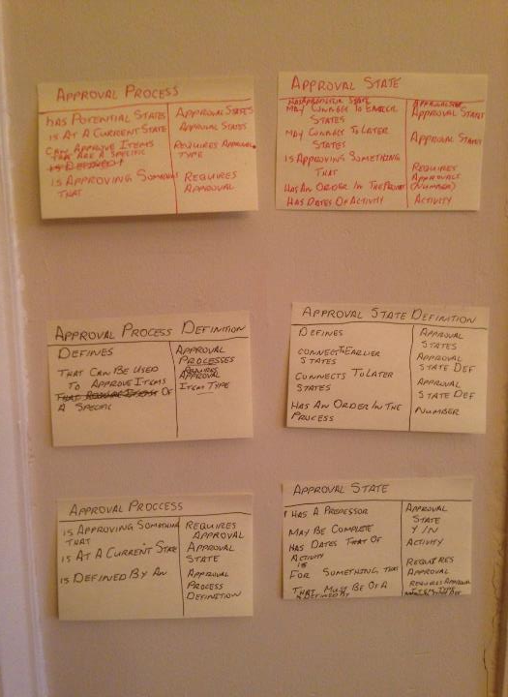
When parts of your system are “configurable” consider moving the configurable part into a separate set of classes, known as a “meta layer”

Slide 45
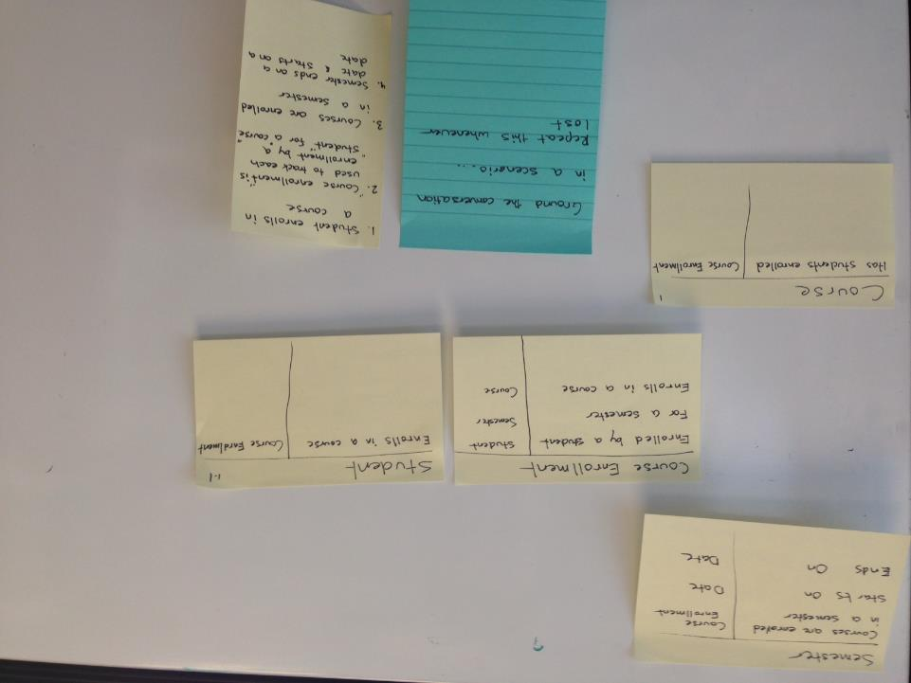
Always ground the conversation by walking the model through a scenario, repeat the scenario walk-through whenever getting “lost in the model

Slide 46
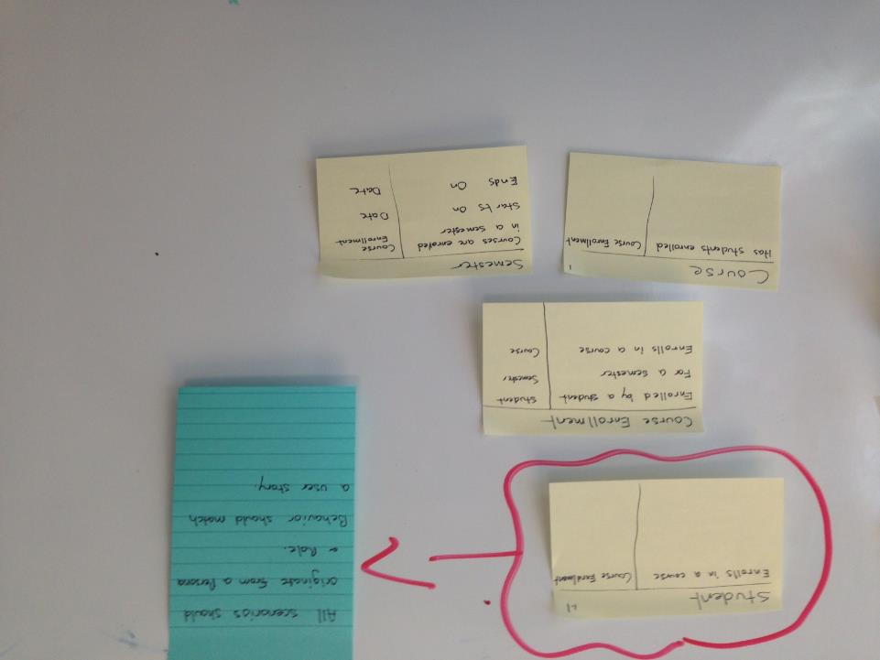
When walking a CRC model in support of a user story or scenario, start with the class that represents a persona, person or role. Make sure that the responsibilities of this “boundary” class aligns to a user story on the story map

Slide 47
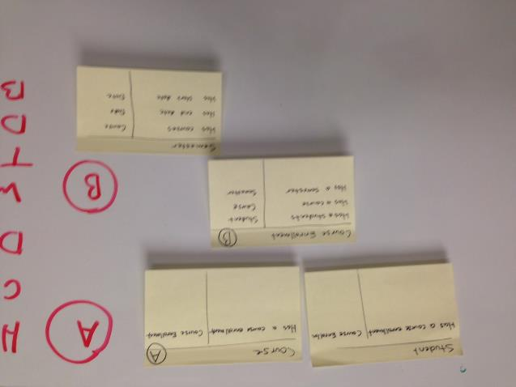
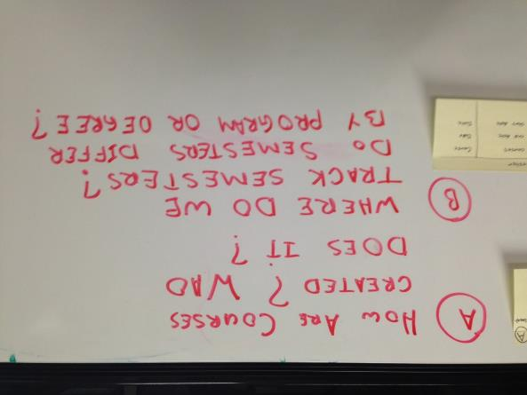
Annotate the model with questions, and require clarifications, then make sure to update the model based on the answers

Slide 48
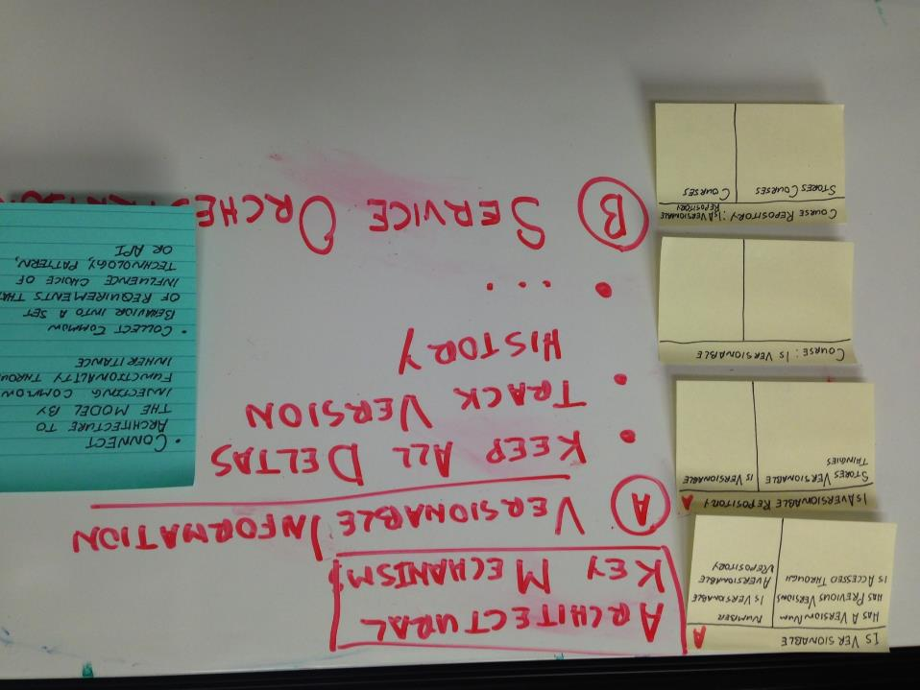
Connect the model to architecture by “injecting” common functionality through inheritance, collect common behavior into a set of requirements that influence the choice of technology, patterns and/or APIs

Slide 49
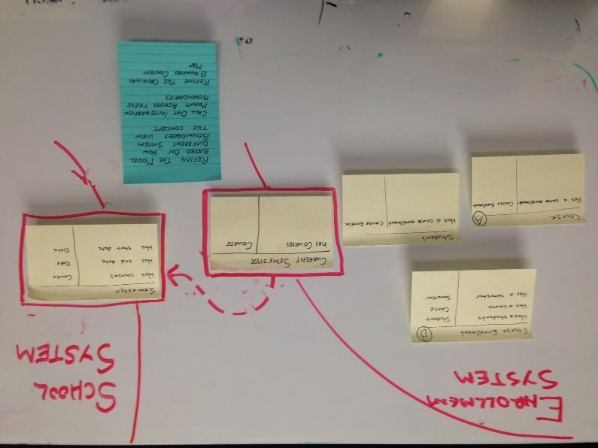
Establish boundaries of meaning across different teams and systems; calling out mapping and integration mechanism
Identify key domain constructs/objects that are relevant to both the business and the system to play
Draw boundaries around constructs according to when the context changes ( different system, different team)
Establish relationships and dependencies across different contexts
For each relationship/dependency identify what integration pattern makes the most sense
Establishing integration approach/policy between context owners for each dependency found

Slide 50
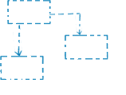

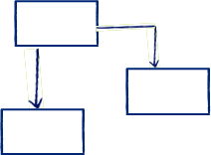
Use a deliberate strategy to ensure that models stay consistent within and across different team and system boundaries
Keep elements in a model boundary consistent
Models will fragment when worked on by multiple parties in parallel
Continuous Integration of both concepts and implementation is required to stay in synch
High level of rigour; only required within an individual bounded countext
`
customer
Synchronize across boundaries according to the nature of the dependency
Establishing clear boundaries for each context in play
Identifying relationships across the different context based on dependencies
Define an integration strategy to govern how different team will resolve and synchronize each cross context dependency
supplier

Slide 51
Exercise: refine your Model based on the best practices above
Make improvements to your model based on the practices that apply to your context
Socialize with team

